Slide 1
Data Mining
UNIT-3
Classification: Advanced Methods

Slide 2
Topics in Classification: Advanced Methods
Classification by Backpropagation
Support Vector Machines
Other Classification Methods
Summary

Slide 3
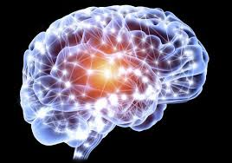
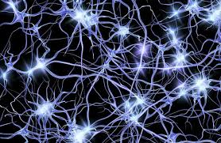
Classification: Advanced Methods

Slide 4
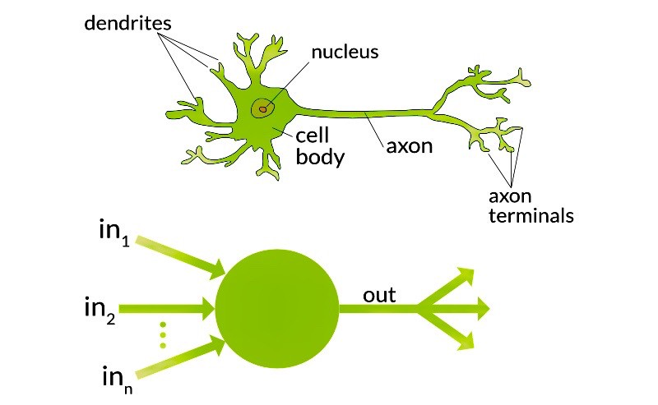
Classification: Advanced Methods

Slide 5
Classification by Backpropagation
Backpropagation: A neural network learning algorithm
Started by psychologists and neurobiologists to develop and test computational analogues of neurons
A neural network: A set of connected input/output units where each connection has a weight associated with it
During the learning phase, the network learns by adjusting the weights so as to be able to predict the correct class label of the input tuples
Also referred to as connectionist learning due to the connections between units

Slide 6
A Multi-Layer Feed-Forward Neural Network
Output vector
Output layer
Hidden layer
w_{ij}
Input layer
Input vector: X
Notes:
MK: Note – different notation than used in book. Will have to standardize notation.

Slide 7
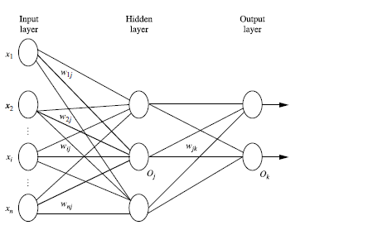
A Multi-Layer Feed-Forward Neural Network
Notes:
MK: Note – different notation than used in book. Will have to standardize notation.

Slide 8
How A Multi-Layer Neural Network Works
The inputs to the network correspond to the attributes measured for each training tuple
Inputs are fed simultaneously into the units making up the input layer
They are then weighted and fed simultaneously to a hidden layer
The number of hidden layers is arbitrary, although usually only one
The weighted outputs of the last hidden layer are input to units making up the output layer, which emits the network's prediction
The network is feed-forward: None of the weights cycles back to an input unit or to the previous layer
From a statistical point of view, networks perform nonlinear regression: Given enough hidden units and enough training samples, they can closely approximate any function

Slide 9
Defining a Network Topology
Decide the network topology: Specify # of units in the input layer, # of hidden layers (if > 1), # of units in each hidden layer, and # of units in the output layer
Normalize the input values for each attribute measured in the training tuples to [0.0—1.0]
One input unit per domain value, each initialized to 0
Output, if for classification and more than two classes, one output unit per class is used
Once a network has been trained and its accuracy is unacceptable, repeat the training process with a different network topology or a different set of initial weights

Slide 10
Backpropagation
Iteratively process a set of training tuples & compare the network's prediction with the actual known target value
For each training tuple, the weights are modified to minimize the mean squared error between the network's prediction and the actual target value
Modifications are made in the “backwards” direction: from the output layer, through each hidden layer down to the first hidden layer, hence “backpropagation”
Steps
  Initialize weights to small random numbers, associated with biases
  Propagate the inputs forward (by applying activation function)
  Backpropagate the error (by updating weights and biases)
  Terminating condition (when error is very small, etc.)

Slide 11
Step1: Initialize the Weights
Initialize the weights:
  The weights in the network are initialized to small random numbers
  e.g., ranging from -1.0 to 1.0, or -0.5 to 0.5.
  Each unit has a bias associated with it.
  The biases are similarly initialized to small random numbers.

Slide 12
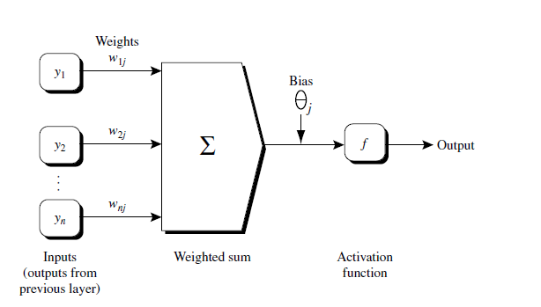
Step 2: Propagating the inputs forward
An n-dimensional input vector x is mapped into variable y by means of the scalar product and a nonlinear function mapping
The inputs to unit are outputs from the previous layer. They are multiplied by their corresponding weights to form a weighted sum, which is added to the bias associated with unit. Then a nonlinear activation function is applied to it.

Slide 13
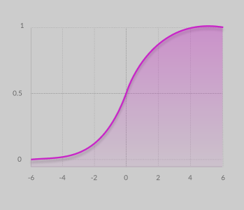
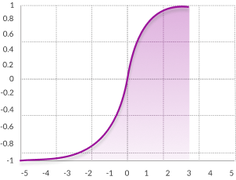
Step 2: Propagating the inputs forward
Different Activation Functions:
Sigmoid Function :
  A = 1/(1 + e^{-x})
  Value Range : 0 to 1
Tanh Function :-
  The activation that works almost always better than sigmoid function
  tanh(x) = 2/(1 + e^{-2x}) - 1 OR
  tanh(x) = 2 * sigmoid(2x) - 1
  Value Range :- -1 to +1

Slide 14
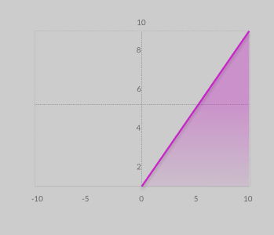
Step 2: Propagating the inputs forward
RELU :- Stands for Rectified linear unit.
  It is the most widely used activation function.
  A(x) = max(0,x).
  It gives an output x if x is positive and 0 otherwise.
  Value Range :- [0, inf)
  In simple words, RELU learns much faster than sigmoid and Tanh function.

Slide 15


Step 2: Propagating the inputs forward
Given a unit, j in a hidden or output layer, the net input, Ij , to unit j is
where wij is the weight of the connection from unit i in the previous layer to unit j; Oi is the output of unit i from the previous layer; and j is the bias of the unit.
Applies an activation function to it. The function symbolizes the activation of the neuron represented by the unit. The ReLu or Tanh, or sigmoid, function is used.
Given the net input Ij to unit j, then Oj , the output of unit j, is computed as

Slide 16
Step 2: Propagating the inputs forward
This function is also referred to as a squashing function, because it maps a large input domain onto the smaller range of 0 to 1.
We compute the output values, Oj , for each hidden layer, up to and including the output layer, which gives the network’s prediction.

Slide 17

Step 3: BackPropagating the Error
The error is propagated backward by updating the weights and biases to reflect the error of the network’s prediction.
For a unit j in the output layer, the error Errj is computed by
where Oj is the actual output of unit j, and Tj is the known target value of the given training tuple.

Slide 18
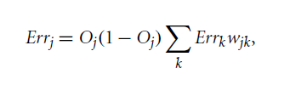
Step 3: BackPropagating the Error
To compute the error of a hidden layer unit j, the weighted sum of the errors of the units connected to unit j in the next layer are considered.
The error of a hidden layer unit j is
where wjk is the weight of the connection from unit j to a unit k in the next higher layer, and Errk is the error of unit k.

Slide 19

Step 3: BackPropagating the Error
The weights and biases are updated to reflect the propagated errors.
Weights are updated by the following equations, where delta wij is the change in weight wij :
The variable l is the learning rate, a constant typically having a value between 0.0 and 1.0.

Slide 20

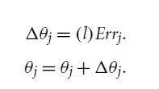
Step 3: BackPropagating the Error
Biases are updated by the following equations, where is the change in bias j :
here we are updating the weights and biases after the presentation of each tuple. This is referred to as case updating.
Alternatively, the weight and bias increments could be accumulated in variables, so that the weights and biases are updated after all the tuples in the training set have been presented. This latter strategy is called epoch updating, where one iteration through the training set is an epoch.
In theory, the mathematical derivation of backpropagation employs epoch updating, yet in practice, case updating is more common because it tends to yield more accurate results.

Slide 21
Step 4: Terminating Condition
Terminating condition:
Training stops when
  All delta wij in the previous epoch are so small as to be below some specified threshold, or
  Error at output layer is below the specified threshold, or
  A pre specified number of epochs has expired.
In practice, several hundreds of thousands of epochs may be required before the weights will converge.

Slide 22
Learning Rate in BackPropagation
Backpropagation learns using a gradient descent method to search for a set of weights that fits the training data so as to minimize the mean squared distance between the network’s class prediction and the known target value of the tuples.1
The learning rate helps avoid getting stuck at a local minimum in decision space (i.e., where the weights appear to converge, but are not the optimum solution) and encourages finding the global minimum.
If the learning rate is too small, then learning will occur at a very slow pace.
If the learning rate is too large, then oscillation between inadequate solutions may occur.
A rule of thumb is to set the learning rate to 1/t , where t is the number of iterations through the training set.

Slide 23
Backpropagation Example
Design and train a neural network for the following dataset.
X1 | X2 | X3 | Class label
1 | 0 | 1 | (1) Yes
1 | 1 | 0 | (0) No
1 | 1 | 1 | (1) Yes
0 | 0 | 1 | (0) No
0 | 1 | 0 | (1) Yes
1 | 0 | 0 | (1) Yes
0 | 0 | 0 | (0) No

Slide 24
Backpropagation Example
Decide the network topology:
Specify # of units in the input layer,
# of hidden layers
# of units in each hidden layer, and
# of units in the output layer
X1 | X2 | X3 | Class label
1 | 0 | 1 | (1) Yes
1 | 1 | 0 | (0) No
1 | 1 | 1 | (1) Yes
0 | 0 | 1 | (0) No
0 | 1 | 0 | (1) Yes
1 | 0 | 0 | (1) Yes
0 | 0 | 0 | (0) No

Slide 25
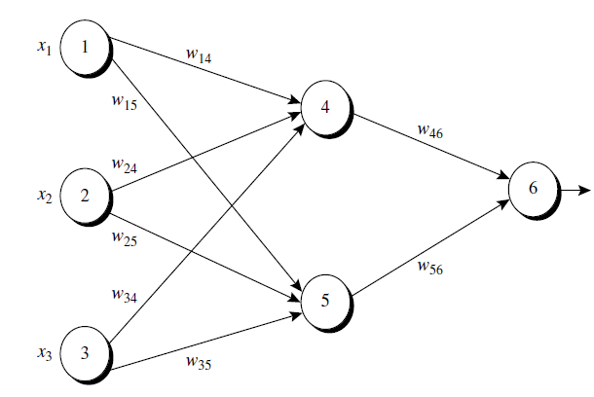
Backpropagation Example

Slide 26
Backpropagation Example
Steps
  Initialize weights to small random numbers, associated with biases
  Propagate the inputs forward (by applying activation function)
  Backpropagate the error (by updating weights and biases)
  Terminating condition (when error is very small, etc.)

Slide 27



Backpropagation Example
Step 1: Initialize the weights and biases

Slide 28

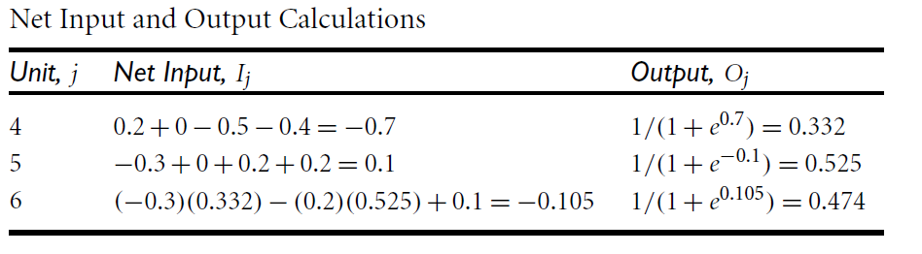
Backpropagation Example
Step 1: Initialize the weights and biases
Step 2: Propagate the inputs forward

Slide 29

Backpropagation Example
Step 3: Back propagate the Error

Slide 30
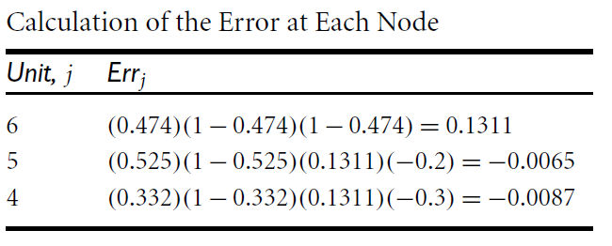
Backpropagation Example
Step 3: Back propagate the Error

Slide 31
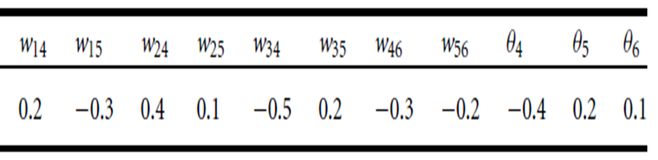
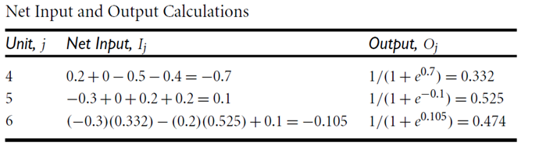
Backpropagation Example
Updating the weights and biases:
Original Weights and biases:

Slide 32

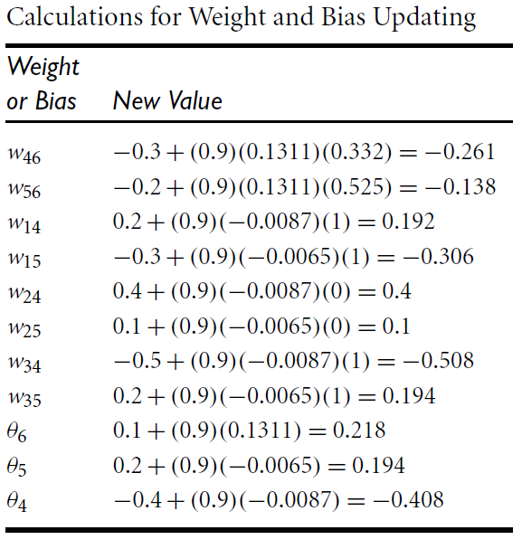
Backpropagation Example
Updating the weights and biases:
Original Weights and biases:

Slide 33
Classification by Backpropagation
How can we classify an unknown tuple using a trained network?”
To classify an unknown tuple, X, the tuple is input to the trained network, and the net input and output of each unit are computed.
If there is one output node per class, then the output node with the highest value determines the predicted class label for X.
If there is only one output node, then output values greater than or equal to 0.5 may be considered as belonging to the positive class, while values less than 0.5 may be considered negative.

Slide 34
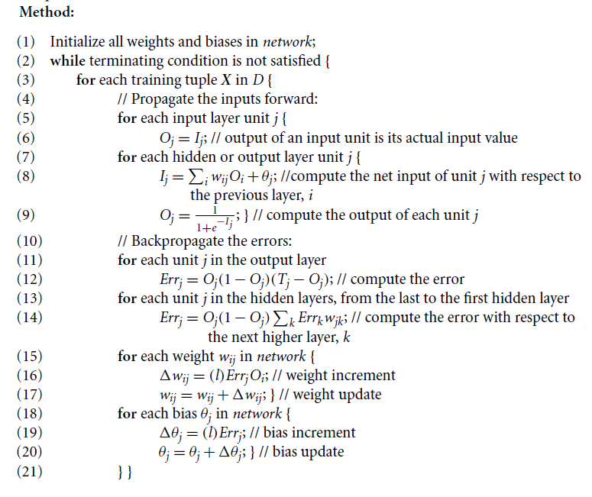
Classification by Backpropagation

Slide 35
Neural Network as a Classifier
Weakness
  Long training time
  Require a number of parameters typically best determined empirically, e.g., the network topology or “structure.”
  Poor interpretability: Difficult to interpret the symbolic meaning behind the learned weights and of “hidden units” in the network
Strength
  High tolerance to noisy data
  Ability to classify untrained patterns
  Well-suited for continuous-valued inputs and outputs
  Successful on an array of real-world data, e.g., hand-written letters
  Algorithms are inherently parallel
  Techniques have recently been developed for the extraction of rules from trained neural networks

Slide 36
Efficiency and Interpretability
“Neural networks are like a black box. How can I ‘understand’ what the backpropagation network has learned?”
A major disadvantage of neural networks lies in their knowledge representation.
Acquired knowledge in the form of a network of units connected by weighted links is difficult for humans to interpret.
This factor has motivated research in extracting the knowledge embedded in trained neural networks and in representing that knowledge symbolically.
Methods include extracting rules from networks

Slide 37
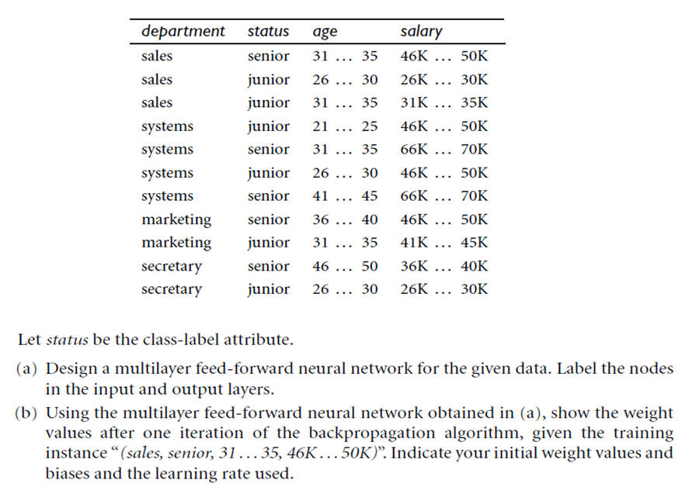
Example for work on Backpropagation

Slide 38
Topics in Classification: Advanced Methods
Classification by Backpropagation
Support Vector Machines
Other Classification Methods
Summary

Slide 39
SVM
Features: training can be slow but accuracy is high owing to their ability to model complex nonlinear decision boundaries (margin maximization)
Used for: classification and numeric prediction
Applications:
  handwritten digit recognition, object recognition, speaker identification, benchmarking time-series prediction tests

Slide 40
SVM—Support Vector Machines
A classification method for both linear and nonlinear data
If not linearly separable, It uses a nonlinear mapping to transform the original training data into a higher dimension
With the new dimension, it searches for the linear optimal separating hyperplane (i.e., “decision boundary”)
With an appropriate nonlinear mapping to a sufficiently high dimension, data from two classes can always be separated by a hyperplane
SVM finds this hyperplane using support vectors (“essential” training tuples) and margins (defined by the support vectors)

Slide 41
SVM—General Philosophy
Small Margin
Large Margin
Support Vectors

Slide 42
SVM—When Data Is Linearly Separable
m
Let data D be (X₁, y₁), …, (X_{|D|}, y_{|D|}), where X_{i} is the set of training tuples associated with the class labels y_{i}
There are infinite lines (hyperplanes) separating the two classes but we want to find the best one (the one that minimizes classification error on unseen data)
SVM searches for the hyperplane with the largest margin, i.e., maximum marginal hyperplane (MMH)

Slide 43
SVM—Linearly Separable
A separating hyperplane can be written as
    W ● X + b = 0
  where W={w₁, w₂, …, w_{n}} is a weight vector and b a scalar (bias)
For 2-D it can be written as
    w₀ + w₁ x₁ + w₂ x₂ = 0
The hyperplane defining the sides of the margin:
    H₁: w₀ + w₁ x₁ + w₂ x₂ ≥ 1 for y_{i} = +1, and
    H₂: w₀ + w₁ x₁ + w₂ x₂ ≤ – 1 for y_{i} = –1
Any training tuples that fall on hyperplanes H₁ or H₂ (i.e., the
sides defining the margin) are support vectors
This becomes a constrained (convex) quadratic optimization problem: Quadratic objective function and linear constraints

Slide 44
Why Is SVM Effective on High Dimensional Data?
The complexity of trained classifier is characterized by the # of support vectors rather than the dimensionality of the data
The support vectors are the essential or critical training examples —they lie closest to the decision boundary (MMH)
If all other training examples are removed and the training is repeated, the same separating hyperplane would be found
The number of support vectors found can be used to compute an (upper) bound on the expected error rate of the SVM classifier, which is independent of the data dimensionality
Thus, an SVM with a small number of support vectors can have good generalization, even when the dimensionality of the data is high

Slide 45


SVM—Linearly Inseparable
Transform the original input data into a higher dimensional space
Search for a linear separating hyperplane in the new space

Slide 46
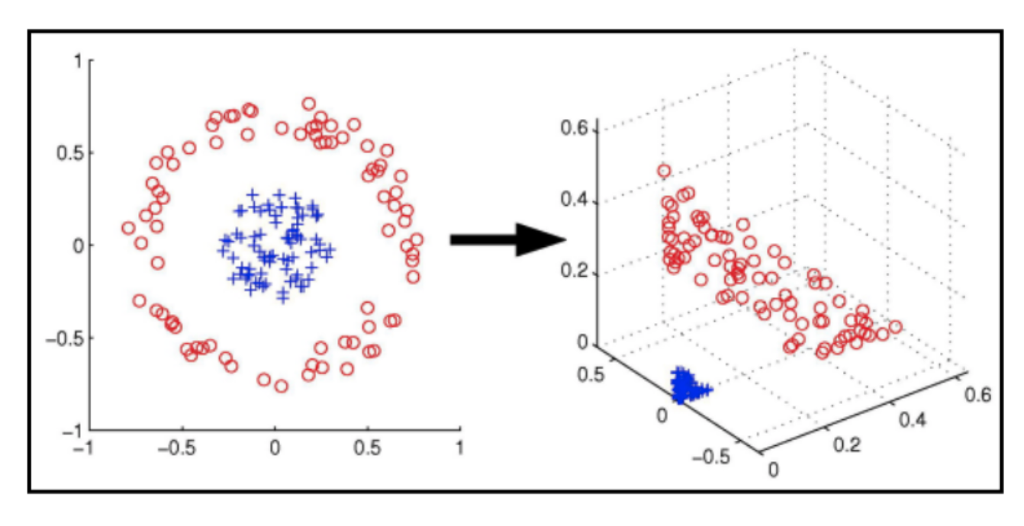
SVM—Linearly Inseparable

Slide 47
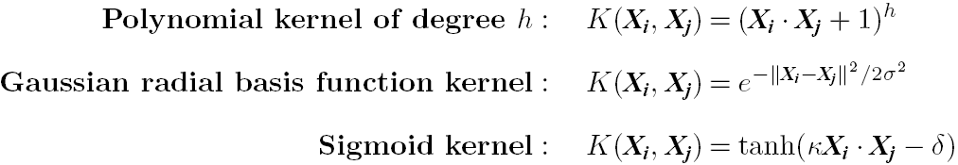
SVM: Different Kernel functions
Instead of computing the dot product on the transformed data, it is math. equivalent to applying a kernel function K(X_{i}, X_{j}) to the original data, i.e., K(X_{i}, X_{j}) = Φ(X_{i}) Φ(X_{j})
Typical Kernel Functions
SVM can also be used for classifying multiple (> 2) classes and for regression analysis (with additional parameters)

Slide 48
SVM vs. Neural Network
SVM
  Deterministic algorithm
  Nice generalization properties
  Hard to learn – learned in batch mode using quadratic programming techniques
  Using kernels can learn very complex functions
Neural Network
  Nondeterministic algorithm
  Generalizes well but doesn’t have strong mathematical foundation
  Can easily be learned in incremental fashion
  To learn complex functions—use multilayer perceptron (nontrivial)

Slide 49
SVM Related Links
SVM Website: http://www.kernel-machines.org/
Representative implementations
  LIBSVM: an efficient implementation of SVM, multi-class classifications, nu-SVM, one-class SVM, including also various interfaces with java, python, etc.
  SVM-light: simpler but performance is not better than LIBSVM, support only binary classification and only in C
  SVM-torch: another recent implementation also written in C

Slide 50
Topics in Classification: Advanced Methods
Classification by Backpropagation
Support Vector Machines
Other Classification Methods
Summary

Slide 51
Genetic Algorithms (GA)
Genetic Algorithm: based on an analogy to biological evolution
An initial population is created consisting of randomly generated rules
  Each rule is represented by a string of bits
  E.g., if A₁ and ¬A₂ then C₂ can be encoded as 100
  If an attribute has k > 2 values, k bits can be used
Based on the notion of survival of the fittest, a new population is formed to consist of the fittest rules and their offspring
The fitness of a rule is represented by its classification accuracy on a set of training examples
Offspring are generated by crossover and mutation
The process continues until a population P evolves when each rule in P satisfies a prespecified threshold
Slow but easily parallelizable

Slide 52

Rough Set Approach
Rough sets are used to approximately or “roughly” define equivalent classes
A rough set for a given class C is approximated by two sets: a lower approximation (certain to be in C) and an upper approximation (cannot be described as not belonging to C)
Finding the minimal subsets (reducts) of attributes for feature reduction is NP-hard but a discernibility matrix (which stores the differences between attribute values for each pair of data tuples) is used to reduce the computation intensity

Slide 53

Fuzzy Set Approaches
Fuzzy logic uses truth values between 0.0 and 1.0 to represent the degree of membership (such as in a fuzzy membership graph)
Attribute values are converted to fuzzy values. Ex.:
  Income, x, is assigned a fuzzy membership value to each of the discrete categories {low, medium, high}, e.g. $49K belongs to “medium income” with fuzzy value 0.15 but belongs to “high income” with fuzzy value 0.96
  Fuzzy membership values do not have to sum to 1.
Each applicable rule contributes a vote for membership in the categories
Typically, the truth values for each predicted category are summed, and these sums are combined

Slide 54
Summary
Effective and advanced classification methods
  Bayesian belief network (probabilistic networks)
  Backpropagation (Neural networks)
  Support Vector Machine (SVM)
  Pattern-based classification
  Other classification methods: lazy learners (KNN, case-based reasoning), genetic algorithms, rough set and fuzzy set approaches
Additional Topics on Classification
  Multiclass classification
  Semi-supervised classification
  Active learning
  Transfer learning

Slide 55
Notes about SVM—
Introductory Literature
“Statistical Learning Theory” by Vapnik: difficult to understand, containing many errors.
C. J. C. Burges. A Tutorial on Support Vector Machines for Pattern Recognition. Knowledge Discovery and Data Mining, 2(2), 1998.
  Easier than Vapnik’s book, but still not introductory level; the examples are not so intuitive
The book An Introduction to Support Vector Machines by Cristianini and Shawe-Taylor
  Not introductory level, but the explanation about Mercer’s Theorem is better than above literatures
Neural Networks and Learning Machines by Haykin
  Contains a nice chapter on SVM introduction

